Slide 1
Risk Analysis with OpenFAIR and Tidyrisk
A Hands-On Introduction
https://tidyrisk.org
Notes:
Confession and story time
Cat lover, and SIRAcon 2012

Slide 2

Pre-Flight Checklist
Get workshop materials from https://github.com/davidski/tidyrisk-workshop
> usethis::use_course(“http://bit.ly/tidyrisk-workshop”)
- or (if you’re fancy) -
# git clone https://github.com/davidski/tidyrisk-workshop.git
Notes:
Pilot cat
Cat with checklist

Slide 3

Our Path this Afternoon
Why Analyze Risk?
Defining Risk Scenarios
Estimating Risk Factors
Quantifying Risk Exposure with Tidyrisk

Slide 4
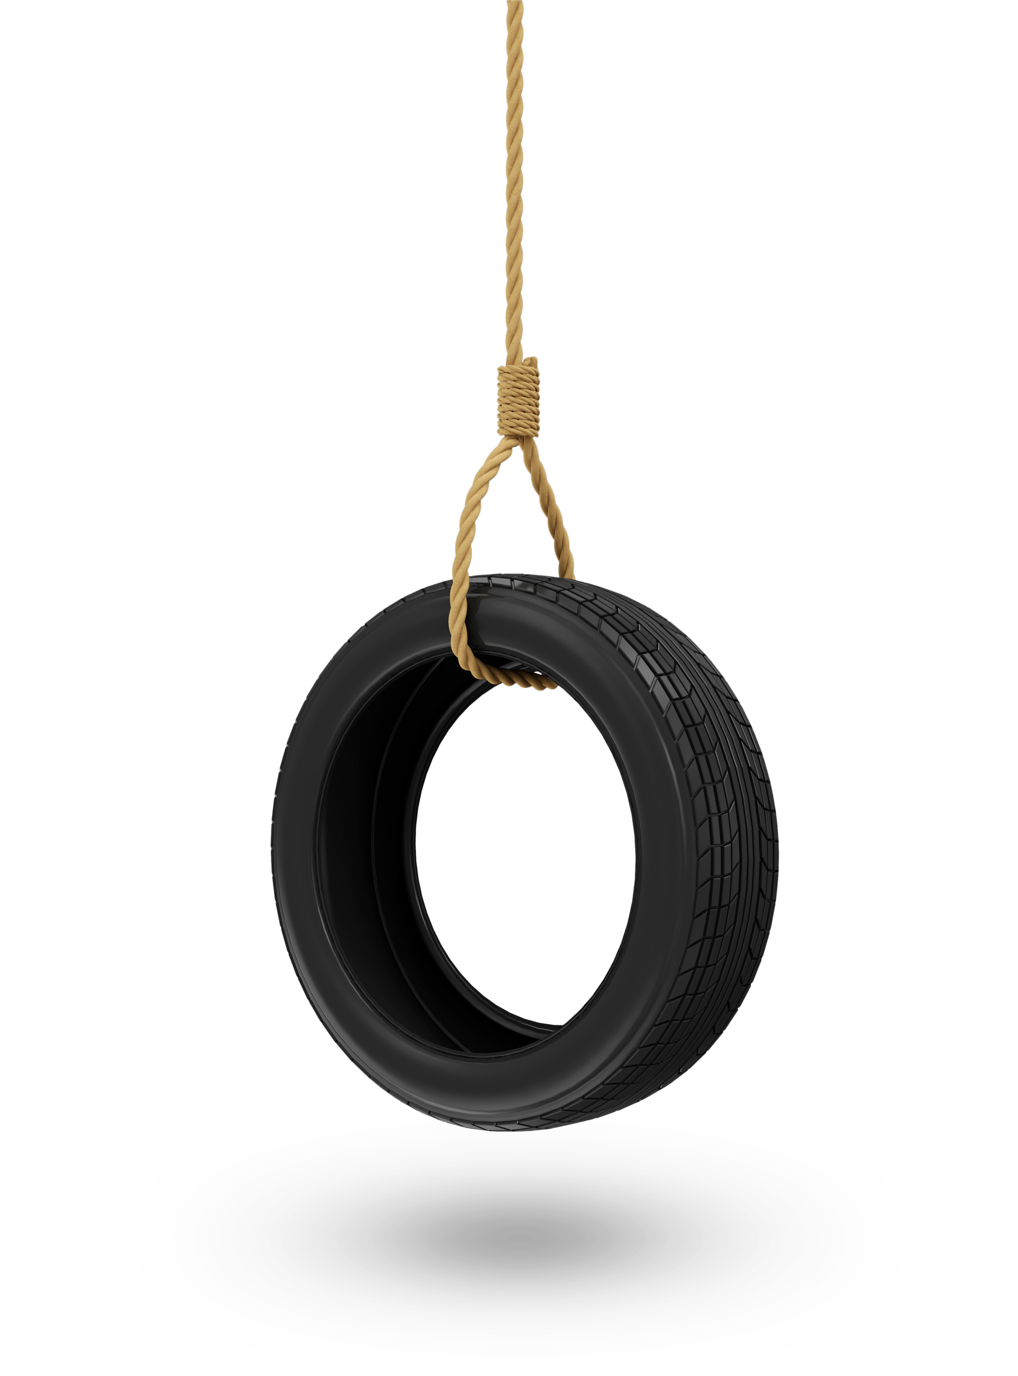
Disclaimer
Notes:
Not OpenFAIR training and I don’t speak on behalf of my employer.

Slide 5
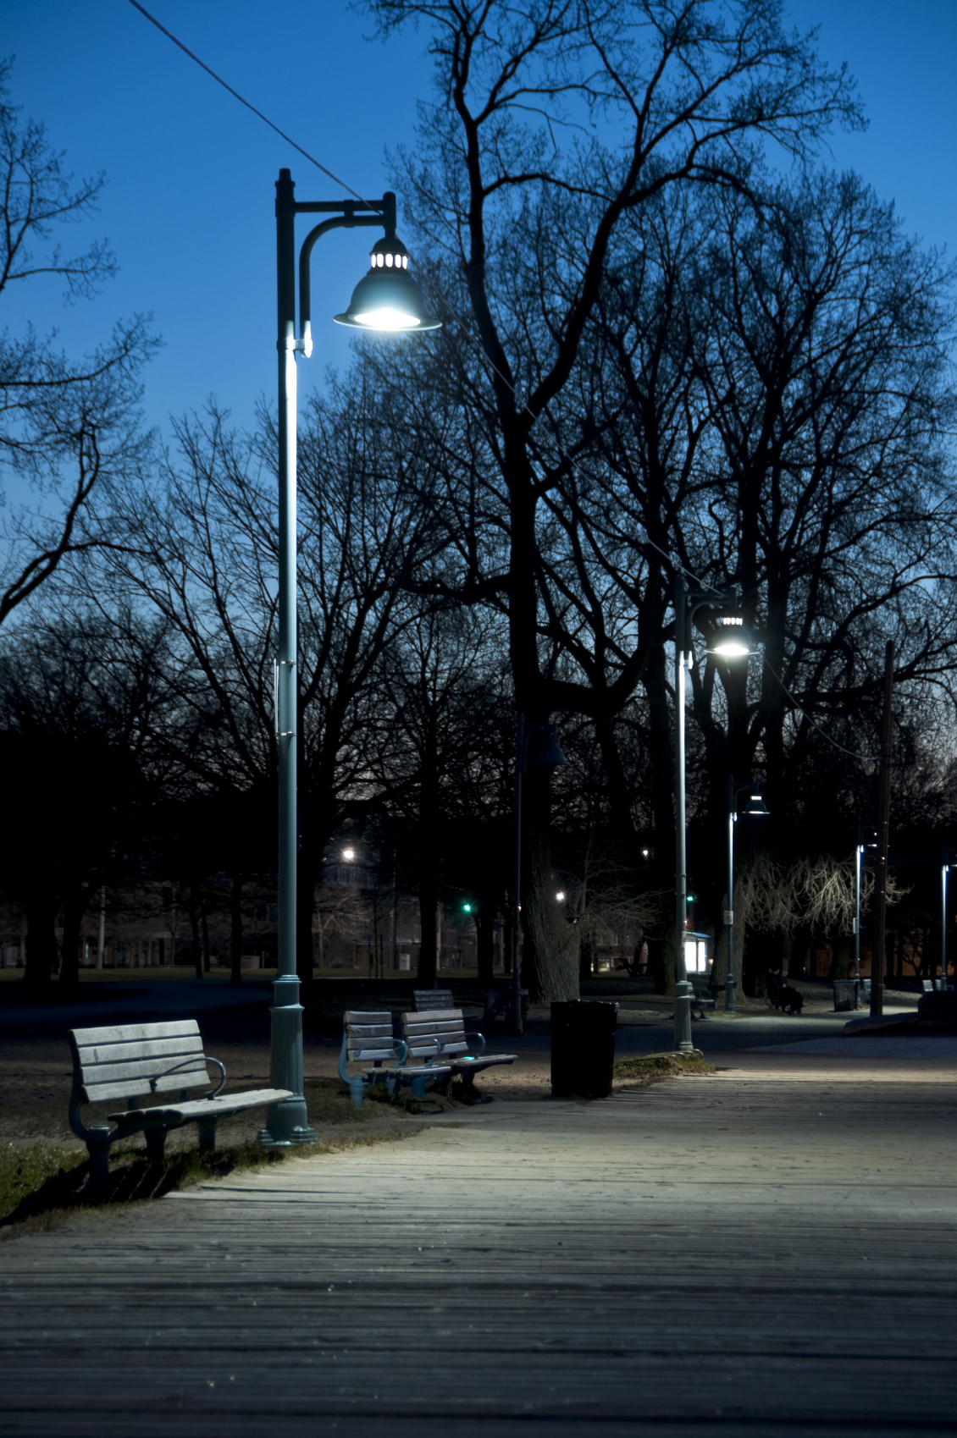
Why Analyze Risk?
Understand why we’re here
Notes:
Why do any of this stuff anyways?
Andrew Lang – Using statistics as a drunk uses a lamppost, more for support than illumination.
In risk – Jason Leuenberger - are we using this as a crutch or a club?

Slide 6

Problem
How do we prioritize risk management efforts?
Given 5 minutes or $5 dollars to spend, where should I spend it?
There are 1,000 worthy projects, but we can only focus on 5. Which ones matter most?
Notes:
Ultimately risk analysis is a decision making tool. Are we doing the most important things right now?
Risk analysis allows us to prioritize scenarios based upon quantified risk (VaR)

Slide 7

Quantitative Answers
Given a risk scenario, what does the future hold?
Value at Risk
Probable Future Loss
Maximum Future Loss
Notes:
Simulation based approach
These values go into our risk register and GRC tools
Risk budget

Slide 8


Hello, Tidyrisk!
Collector
Evaluator
Notes:
Collector helps define scenarios, calibrates SMEs, gathers inputs, generates data inputs
Evaluator runs simulations and produces reports, also can handle qualitative inputs!
We’ll cover only Evaluator in today’s session

Slide 9
Tidyrisk Flows – Single Scenario
Define Scenario
Gather Inputs
Run Simulations
Report
Notes:
Today’s focus

Slide 10
Tidyrisk Flows – Multi-Scenario Qualitative Analysis
Define Scenarios
Gather Inputs
Create Quantitative Scenarios
Run Simulations
Generate Materials
Map Inputs
Prepare Scenarios
Report
Create Templates
Update Scenarios

Slide 11
Tidyrisk Flows – Full Quantitative Analysis
Define Scenarios
Gather Inputs
Create Quantitative Scenarios
Run Simulations
Generate Materials
Fit Parameters
Combine
Prepare Scenarios
Report
Run Interviews
Notes:
A full quantitative process

Slide 12

Defining a Risk Scenario
Orient to the OpenFAIR framework
Describe a structured risk scenario
Notes:
So what does a risk scenario look like? Remember that we’re looking to make a decision.
THIS IS MY FAVORITE (non cat) SLIDE – Defining the problem is really important

Slide 13
OpenFAIR Ontology
RISK
LEF
TEF
VULN
TC
DIFF
LM
PLM
SR
SLEF
SLM
Notes:
Quick discussion of OpenFAIR
There are many risk frameworks, this one is ours. ☺
Structured way of decomposing the factors of risk

Slide 14

Today’s Focus
RISK
LEF
TEF
VULN
TC
DIFF
LM
PLM
SR
SLEF
SLM
Notes:
Evaluator’s primary out of the box level of details is TEF_TC_DIFF_PLM
Where I find most of the value, but your experience may differ

Slide 15
A Well-Formed Risk Scenario
Who/What is doing what action against what asset that results in what loss?
Narrative | OpenFAIR Element | Scale
Who/What – How frequently may attempts be made? | Threat Community (TEF) | Events per year
What action – How much force is acting against the asset? | Threat Capability (TC) | Percentage
What asset – How well are we pushing back against the attack? | Difficulty (DIFF) | Percentage
What loss – How bad does it hurt, per event, when the bad thing occurs? | Loss Magnitude (LM) | Dollars (or other currency) per event occurrence
Notes:
Before we can run simulations, we need to identify what we’re analyzing

Slide 16
Incomplete “Risks”
Our password rotation policies are not strong enough.
Cyber adversaries may compromise administrative credentials on our public web site, allowing access to customer information.
The company’s consumer web app is vulnerable to resilience outages.
A failure in the primary region of our cloud provider may result in a prolonged outage on our primary web application.
We are not competitive for talent in the local job market.
We are unable to compete with the local job market, causing us to loose key talent on our major initiative.

Slide 17

Exercise 1 – Identifying Factors
Think of a risk situation applicable to your work
Identify the OpenFAIR factors of this risk scenario
Discuss with your neighbor
Notes:
Identify the factors in a scenario and discuss with your neighbor

Slide 18

Gathering Inputs
Creating estimates for a risk scenario
Notes:
Now that we have a scenario, let’s get some data

Slide 19

Creating Estimates
How do we estimate?
Looking for a 90% confidence interval
Each estimate has two values:
A high (95 percentile)
A low (5 percentile)
Questions to Ask
What data sources could we use?
To whom could we talk?
Notes:
Reference sources
Data element

Slide 20
Exercise 2 – Estimating Factors
For each of the OpenFAIR factors you identified in your scenario, create a 90% confidence High-Low estimate
Discuss your reasoning with your neighbor
Remember
Frequency (TEF): # of opportunities per year
Threat Capability (TC): Strength of the adverse force (%)
Difficulty (DIFF): Strength of our capabilities (%)
Loss Magnitude (LM): $ per event
Notes:
Estimate each element
State that this is not an analyst-in-a-dark-room exercise, but a collaborative work-with-SMEs conversation. (Side note, this is where Collector comes in! ☺ )
This also helps with calibration!

Slide 21
Working with Tidyrisk
Build a Tidyrisk scenario
Running simulations
Notes:
Let’s do some analysis!

Slide 22
Exercise 3 – Interactive Exploration
Run the OpenFAIR Example application
> library(evaluator)
> openfair_example()
Enter your estimates
Run a simulation
Explore the results
What happens if your controls get 10% better?
What happens if the threat strength increases by 10%?
Notes:
Hands on with the shiny app
Record your parameters

Slide 23
Exercise 4 – Building a Scenario
Translate your scenario into a tidyrisk_scenario object
Use the RStudio Add-in
Tools:Addins:Browse Addins…
Print the scenario
> print(my_scenario)
Display the scenario parameters
> as_tibble(my_scenario)
Notes:
Hands on with code

Slide 24
Running a Simulation
> my_results <- run_simulation(my_scen, iterations = 1000)
Notes:
Run a simulation
- given a scenario object
- number of iterations to perform

Slide 25
Review the Results
> glimpse(my_results)
Variable | Meaning
Iteration | Identifier of the simulated year
# of threat events | Number of threat events that occurred in this iteration
# of loss events | Number of threat events that results in losses
Vulnerability | Percentage of threat events that became losses
TC exceedance | Margin by which the threat action ”won” over the controls
DIFF exceedance | Margin by which the controls “won” over the threat
ALE – annual loss exposure | Total annual losses for that iteration
SLE – single loss exposure | Single loss event size (min, max, median, mean)
Notes:
Show the results as a dataframe/ (aka a data table)
What do you get?
Do this on your scenario!

Slide 26
Summarizing the Results
> summarize_scenario(my_results)
Variable | Meaning
# of loss events | Number of threat events that results in losses
ALE | Total annual losses (median, max, VaR 95)
SLE | Single loss event size (min, max, median, mean)
TC exceedance | Margin by which the threat action ”won” over the controls
DIFF exceedance | Margin by which the controls “won” over the threat
Vulnerability | Percentage of threat events that became losses
Notes:
What’s the bottom line? It’s VAR!

Slide 27
Graphical Representations
Histogram of possible future losses
> exposure_histogram(my_results)
Generate a scatterplot of loss events
> loss_scatterplot(my_results)
Notes:
Describe what these are and do.

Slide 28
Exercise 5
Expanding from one to many
From evaluator.tidyrisk.org
Review the sample risk report
https://evaluator.tidyrisk.org/reports/evaluator_risk_analysis.html
Review the sample risk dashboard
https://evaluator.tidyrisk.org/reports/evaluator_risk_dashboard.html
Review the sample scenario explorer
https://davidski.shinyapps.io/scenario_explorer
Notes:
May go into more or less on this in the interest of time.

Slide 29

Look At What We’ve Done Today!
Defined a risk scenario
Estimated parameters for risk factors
Simulated a scenario with evaluator
Interpreted risk results
Notes:
Amazed cat, smart cat

Slide 30
Oh, The Places You’ll Go!
Multiple scenario analysis
Building a library of scenarios
Collecting subject matter experts input
https://tidyrisk.org

Slide 31



Enjoy the rest of conference!
Collector and Tidyrisk hex stickers available!
Notes:
Grab a sticker!

